Slide 1


DEPARTMENT OF COMPUTER SCIENCE & ENGINEERING
Subject Name: Multimedia Technologies
Subject Code: (20CST-334/20ITT-334)
Lecture 18
Topics Covered: White balance correction
DISCOVER . LEARN . EMPOWER

Slide 2
White balance correction
Use white balance (WB) correction as a filter effect, while keeping the two axes in mind
The WB correction feature ([WB Shift/Bkt.]) can be used not only to faithfully reproduce the colours of the subject, but also as a filter effect that adds the characteristics of different colours to your photos.
When using this feature, there are two axes you should keep in mind. The first is the B (Blue)/A (Amber) axis on which you can make simple adjustments to the colour temperature to make colours appear cooler or warmer. The second axis is the G (Green)/M (Magenta) axis, which lets you add unique colours to your photos that are difficult to obtain using the preset White Balance settings.

Slide 3
White balance correction
If you are using WB correction to create a colour filter effect, try adjusting it with the G/M axis in mind. To settle on a colour that suits your preference, I would firstly recommend specifying a preset White Balance mode, such as "Sunlight", "Shade", or "Cloudy, twilight, sunset", to roughly set the coolness or warmth of the colour temperature, before using the G/M axis to add your preferred colour tone. The final step would then be to use the B/A axis to adjust the overall colour.

Slide 4
White balance correction
The final impression will differ depending on the subject. However, in general, a shift in the G (green) direction will create a younger and more refreshing impression, while a shift in the M (magenta) direction will create a more mature, solemn impression in your images.

Slide 5
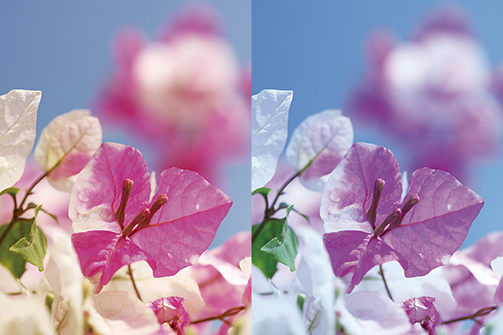
White balance correction
Light appears in different colours (e.g. Light from a fluorescent lamp tends to be greenish while light from an electric bulb tends to be red or orange). White balance corrects the impact that the colour of light has on a picture. Let's take a look at the types and effects of white balance.

Slide 6
White balance correction
Knowing the meaning of White Balance and understanding its use
Unlike a film camera, a digital camera is able to take photos with the right hue under any light source. This function to adjust the hue is known as white balance. The basic concept of white balance lies in “reproducing a white object in white under any light source”. It corrects the colour tone that arises when a photo is taken under a specific light source by enhancing its complementary colour (clashing colour). The photos below are all taken in daylight with only the white balance setting changed. The colour tone that is generated in each white balance photo shows the complementary colour when corrected. A colour filter is used to correct these colour tones in film photography.

Slide 7
White balance correction
The basic principle is also similar in a digital camera with white balance being equivalent to a colour filter. However, there is no corresponding “Auto White Balance (AWB)” in a colour filter. AWB is sufficient for normal use but it is probably good to use various types of white balance when the hue does not match under specific conditions.

Slide 8
Any query ??

Slide 9
Thank you

